Slide 1
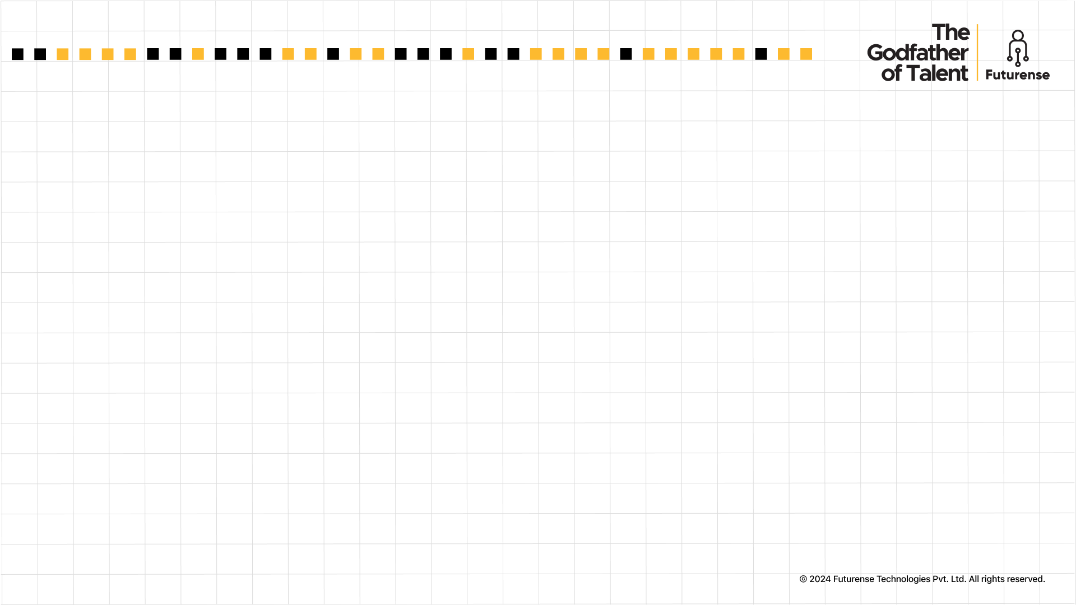

Futurense Technologies
Project Report
Data-driven Decisions: Leveraging Football Statistics for Success
Group Name: Strategy Stars
Names:
1. Hitha Choudhary G - 22BTRAD015
2. K Shreeshanth - 22BTRAD017
3. Lakshya Sharma - 22BTRAD021

Slide 2


Index
1. Introduction
2. Project Statement
3. Description
4. Figures/Graphs
5. Challenges Faced
6. Conclusion
7. References

Slide 3
Introduction
The provided dataset offers a rich view of player performance and characteristics. It includes:
Player Identification: Unique ID and player name.
Team Affiliation: Team the player belongs to.
Physical Attributes: Age, height, and weight.
Playing Style: Position on the field.
Performance Metrics: Goals, assists, cards, passing accuracy, distance covered, etc.
Training and Fitness Data: Training hours, fatigue levels, injury history, and related metrics.
This variety of features allows for comprehensive analysis of player performance, fitness, and potential areas for improvement.

Slide 4
Project Statement
Year-Long Data Engineering Project: Comprehensive Storyline and Problem Statements
Goal: As a Data Engineer our main aim is to leverage data to gain insights into player performance and team strategies from the sports dataset given.
Month 1-3: Introduction and Data Familiarization
Task 1: Includes handling missing values, correct anomalies by handling outliers, standardize data formats and data augmentation.
Task 2: Analyze player positions, use statistical analysis and create bar chart and pie charts. Using chi-square test to validate our findings.
Month 4-6: Data Ingestion and Initial Analysis
Task 1: Implementing data ingestion pipeline to support incremental loading, storage optimization and logging to monitor and track the process.
Task 2: Pass completion rate vs Assists using a scatter plot, identifying outliers with DBSCAN/Isolation Forest. Regression analysis to model the relationship and evaluation with relevant metrics.

Slide 5
Project Statement
Month 7-9: Advanced Data Transformation and Warehousing
Task 1: Feature Engineering, complex transformations, normalization & dimensionality reduction and machine learning techniques.
Task 2: Data warehouse schema , store data efficiently to support complex queries. Additionally, it will be optimized for performance using indexing, with security and access controls implemented.
Month 10-12: Reporting and Visualization
Task 1: Identify the top scoring team, visualize goal trends (horizontal bar chart, stacked bar chart) and scorer performance (time series analysis, advanced visualizations).
Task 2: Build interactive dashboards (Power BI, Tableau, Dash, Streamlit) for player/team analysis, use clustering & prediction for future performance insights.

Slide 6
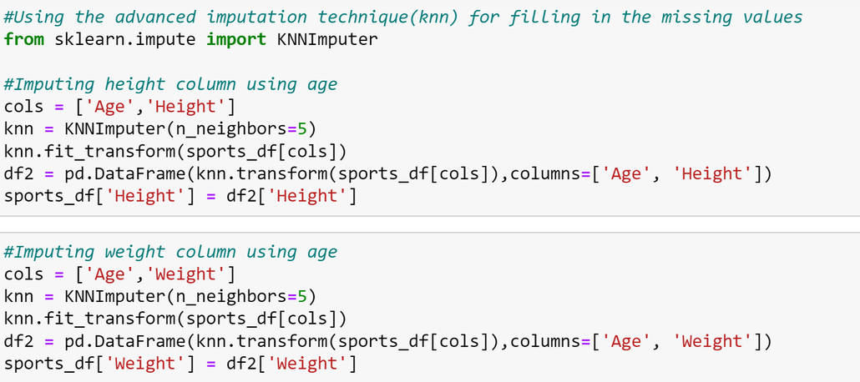
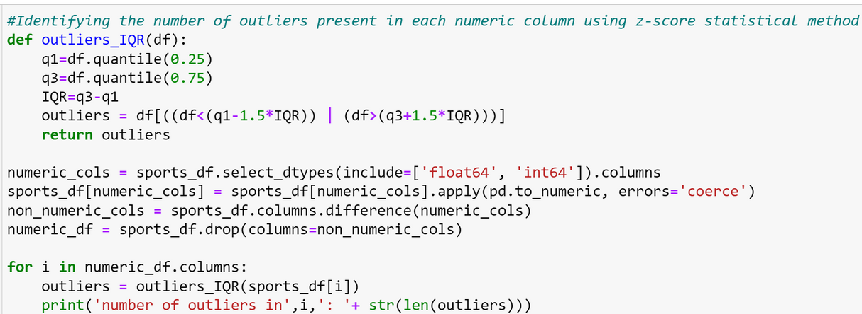
Description
Problem Statement-1: Data Cleaning and Augmentation
Handling missing values using fillna and knn provided a more clear and precise dataset.
Outlier detection was done using IQR method and it was imputed using mean value of each column.

Slide 7

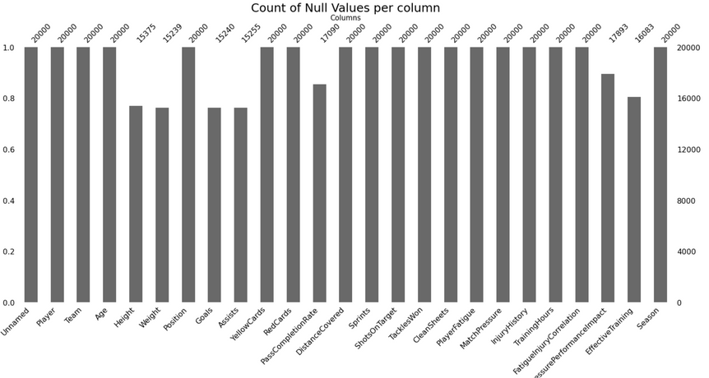
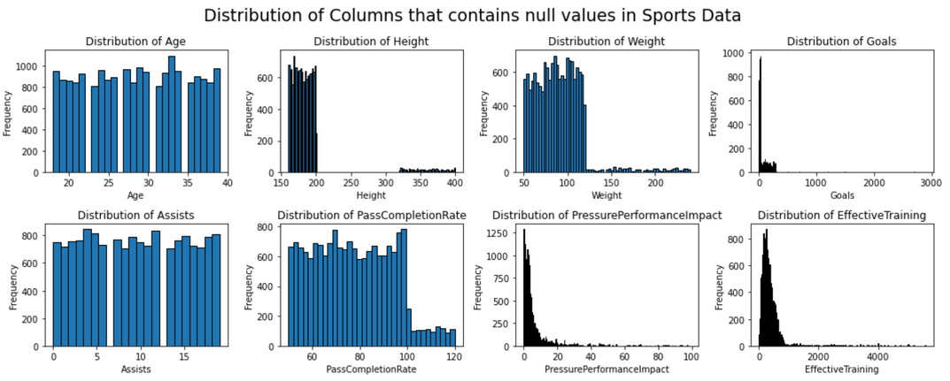
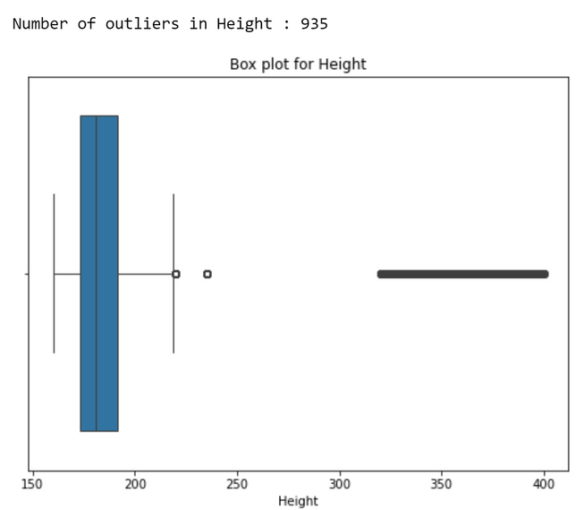
Figures/Graph
Problem Statement 1: Data Cleaning and Augmentation

Slide 8
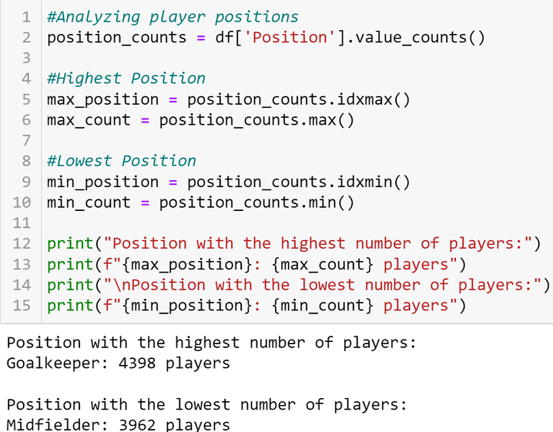
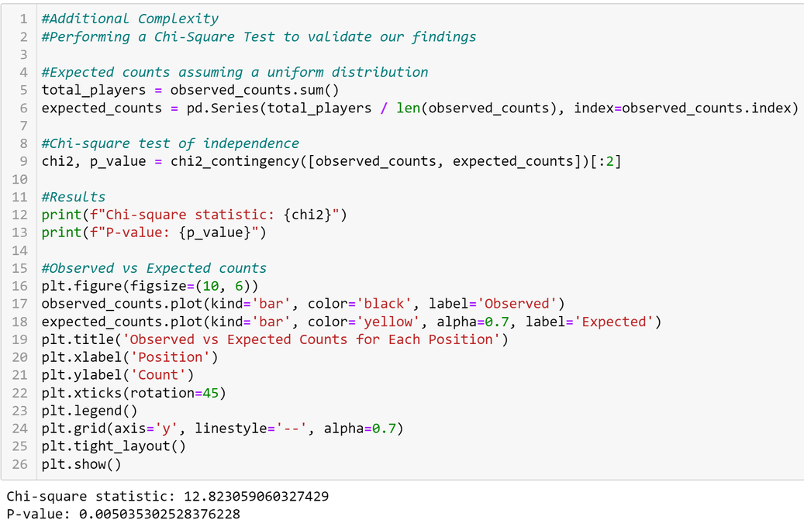
Description
Problem Statement-2: Position Analysis
Found the number of players playing for each position, the maximum was goalkeeper meanwhile lowest was midfielder.
To further validate the findings, chi square test was conducted, hence the results were validated

Slide 9
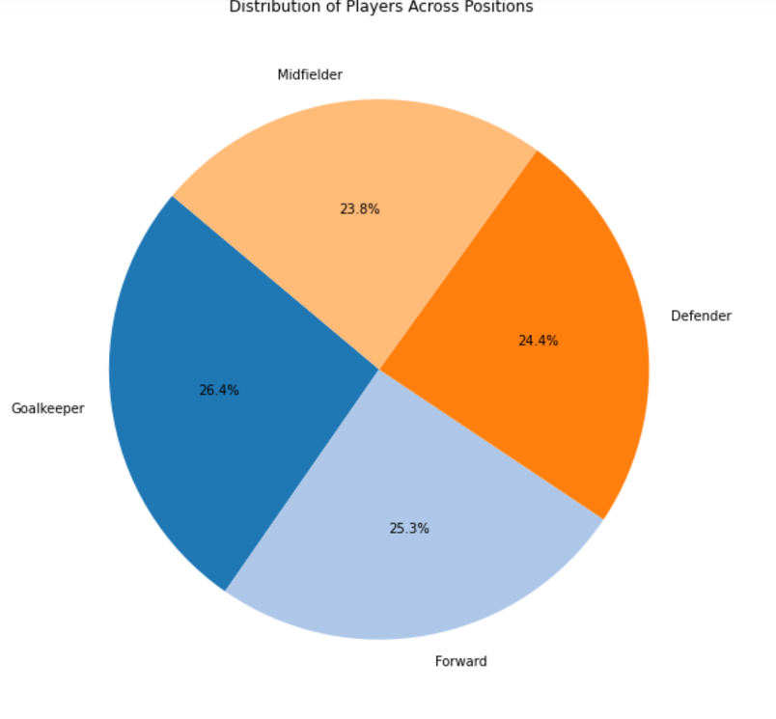
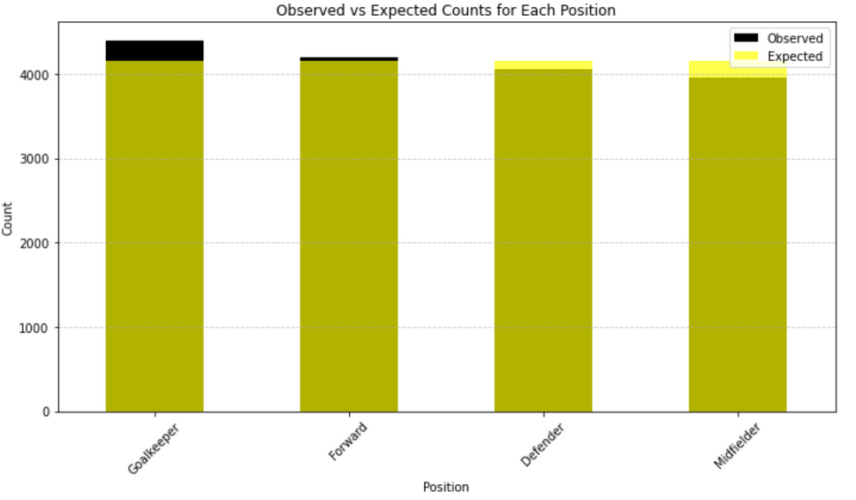
Figures/Graph
Problem Statement 2: Position Analysis

Slide 10
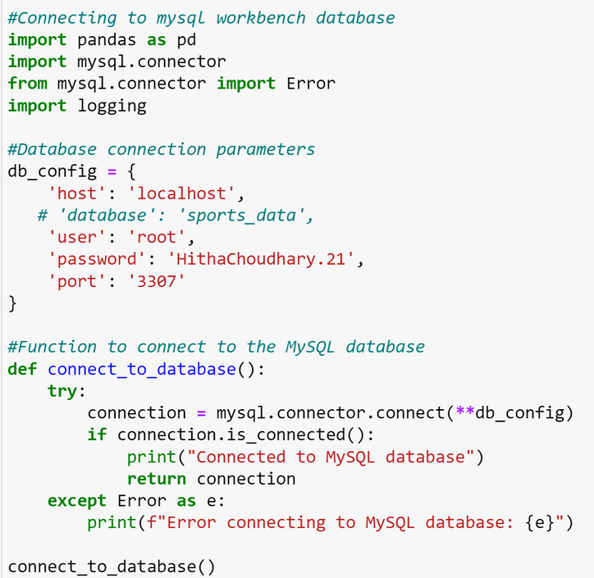
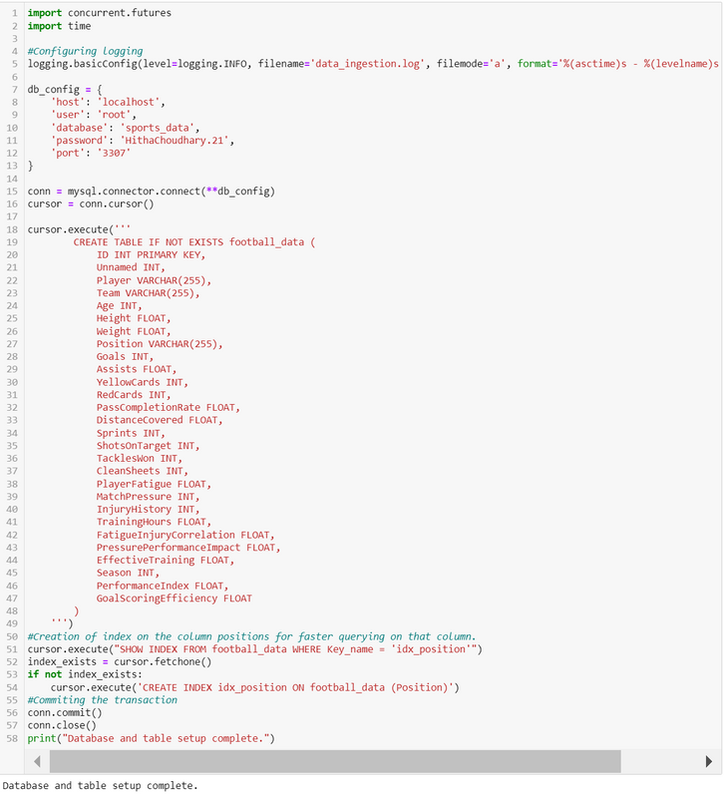
Description
Problem Statement-3: Data Ingestion Strategies
Connecting to the MySQL server database
Ingesting the data in a bulk
Creation of index to optimize storage
Implementation of logging to monitor and track the ingestion process

Slide 11
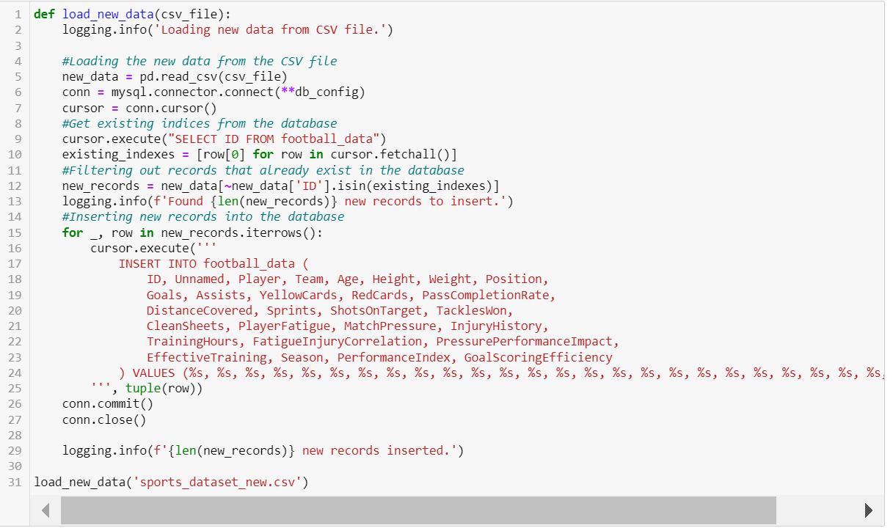
Description

Slide 12
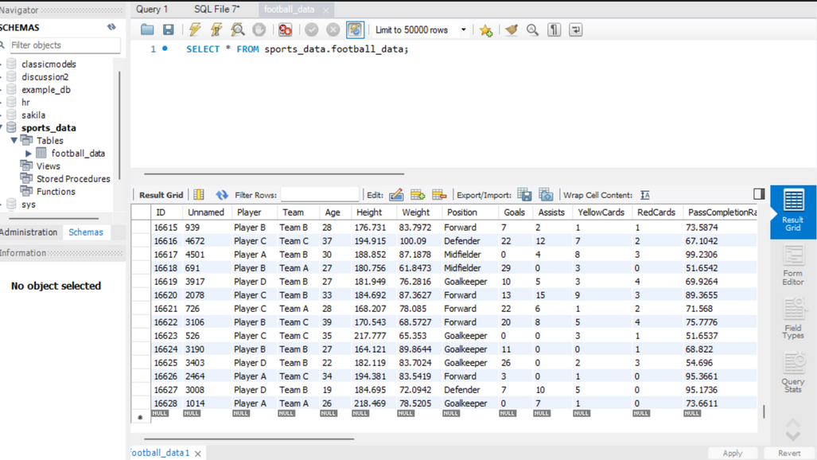
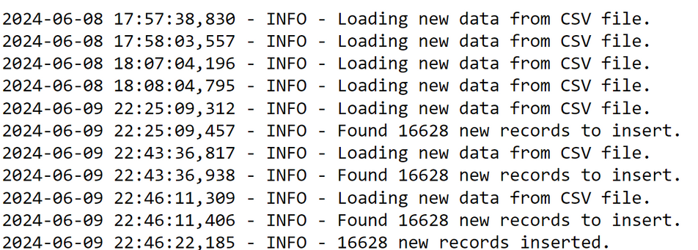
Figures/Graph
Problem Statement 3: Data Ingestion Strategies

Slide 13
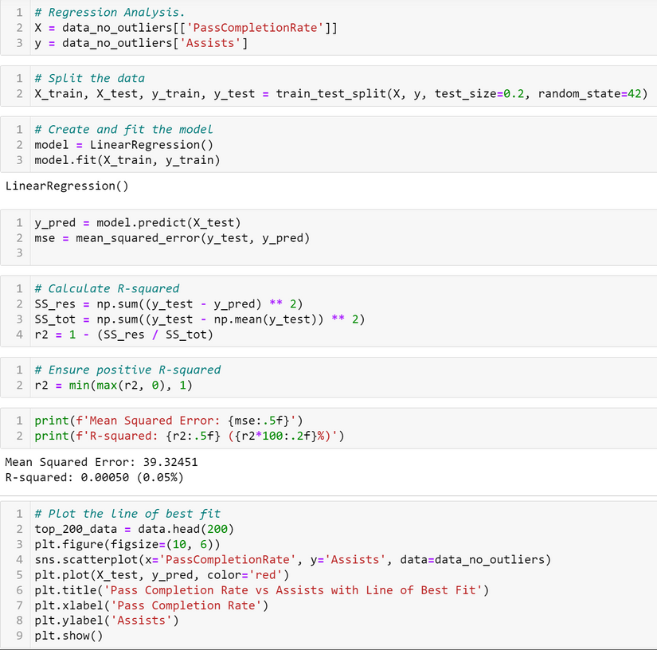
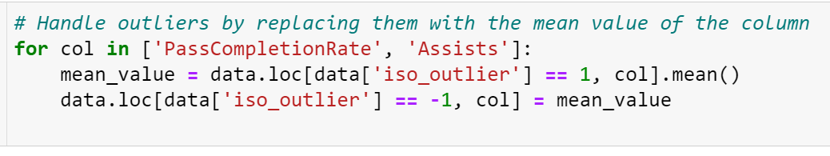
Description
Problem Statement-4: Pass Completion Rate vs Assists
(1)To identify outlier using DBSCAN.
(2) To identify outlier using isolation forest and handling them.
(3)Using the handled data for liner regression analysis to find the best fit line.
(4)Scatter plot is used for visualization.

Slide 14
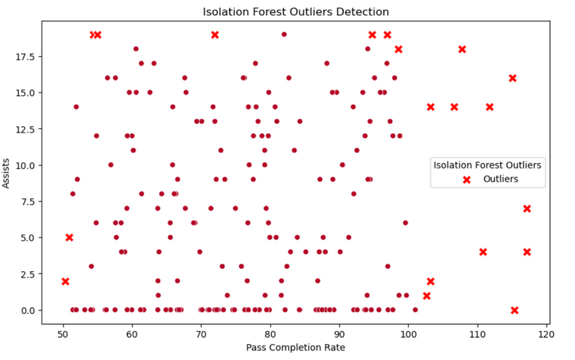
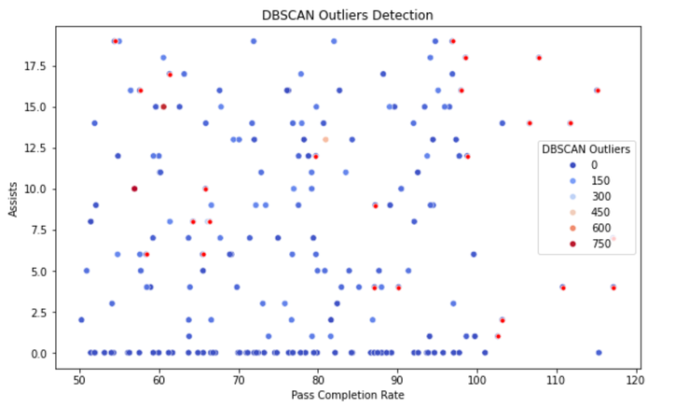
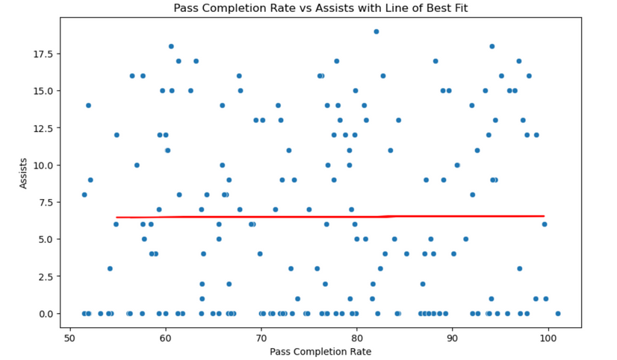
Figures/Graph
Problem Statement 4: Pass Completion Rate vs Assists

Slide 15
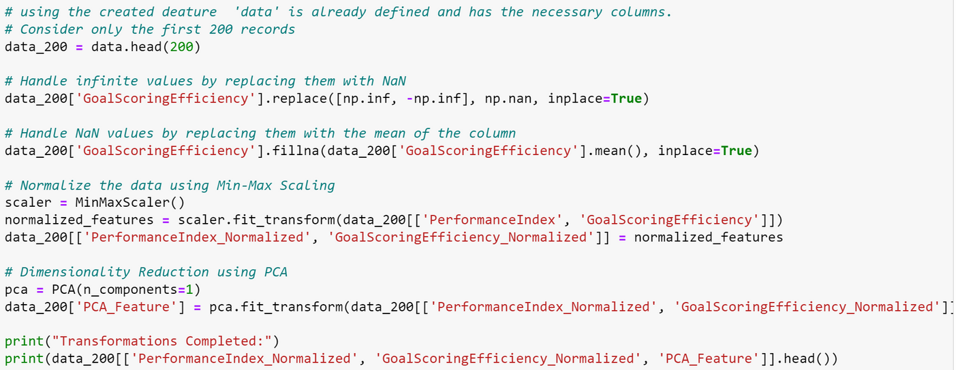
Description
Problem Statement-5: Advanced Data Transformations
1.Feature creation
2.Feature transformation using PCA.
3.Feature selection using Random Forest Regressor
4.Feature extraction using PCA.

Slide 16
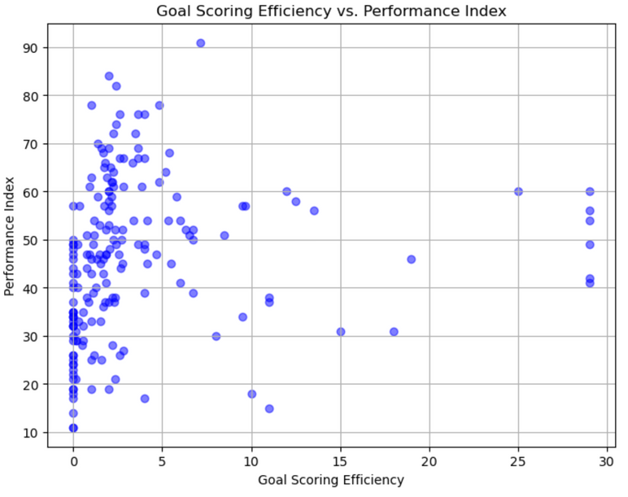
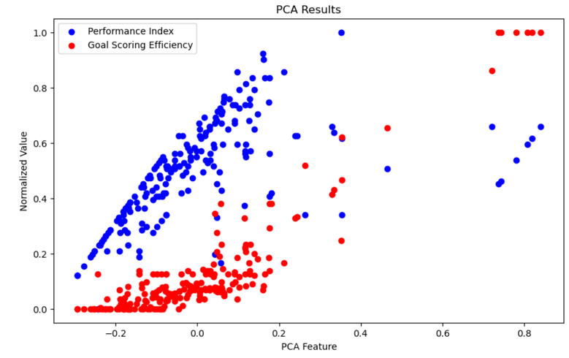
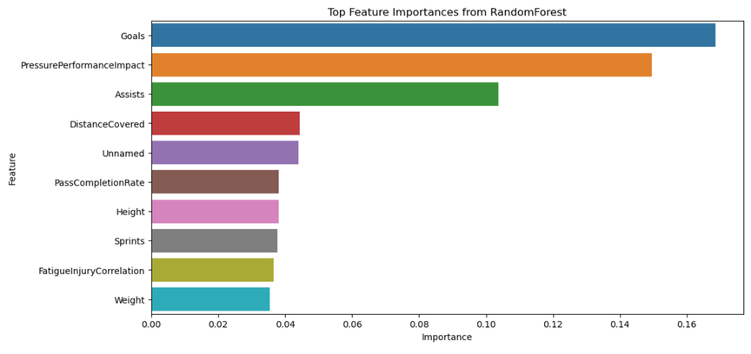
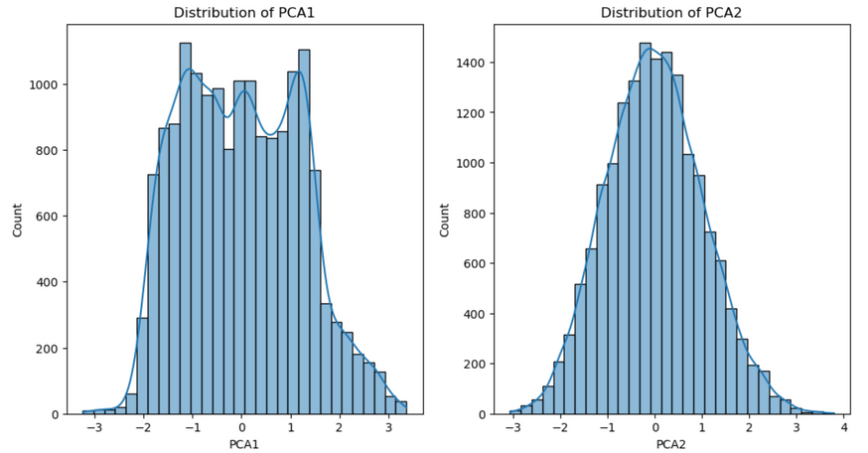
Figures/Graph
Problem Statement 5: Advanced Data Transformations

Slide 17
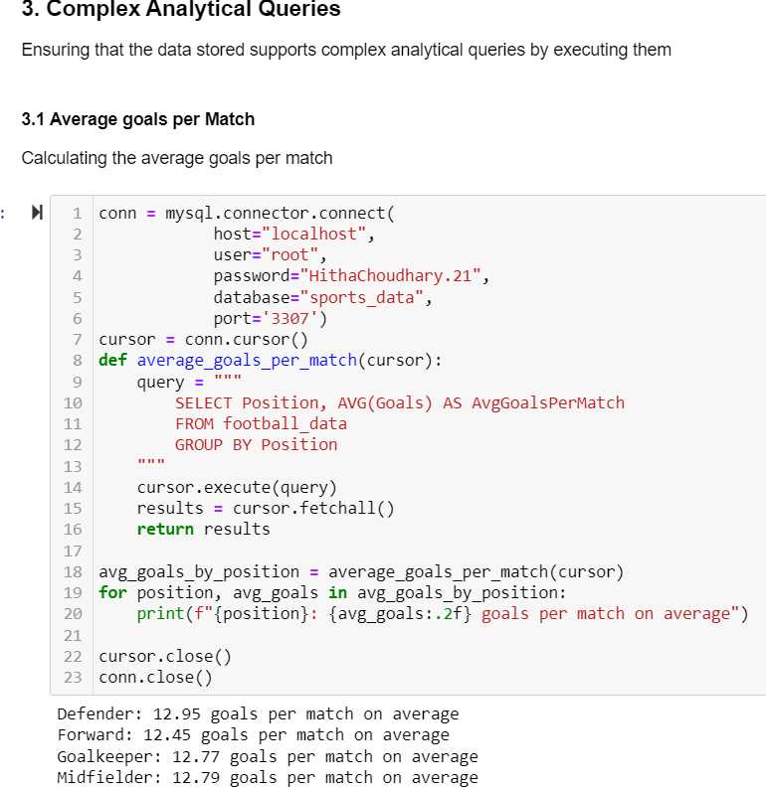
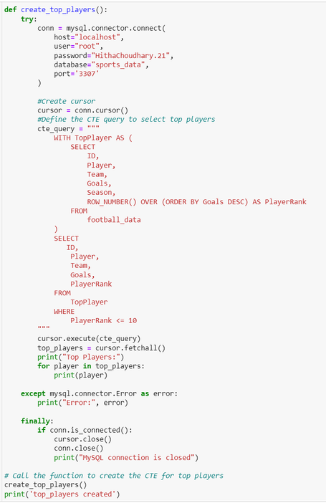
Description
Problem Statement-6: Data Warehousing
Creation of tables using MySQL WorkBench
Executing an example usage of CTE for representing top players in the dataset
Ensuring that the data stored supports complex analytical queries by executing them
Data Security and Access Control Mechanisms

Slide 18
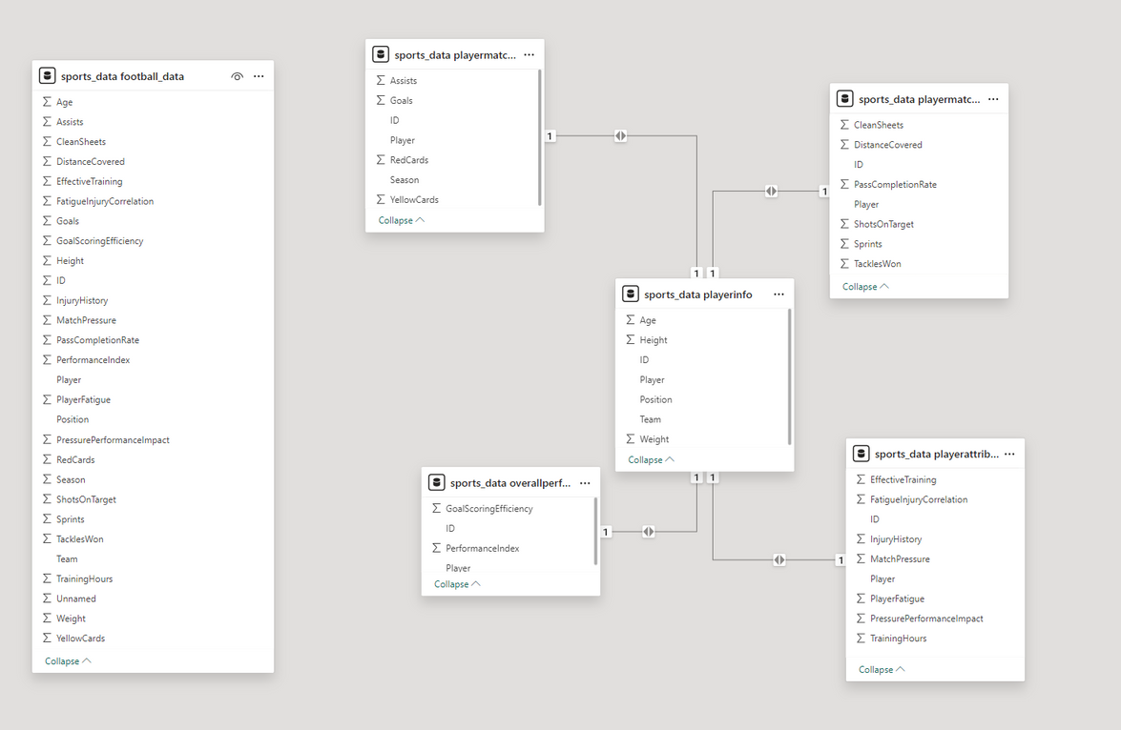
Figures/Graph
Problem Statement 6: Data Warehousing

Slide 19
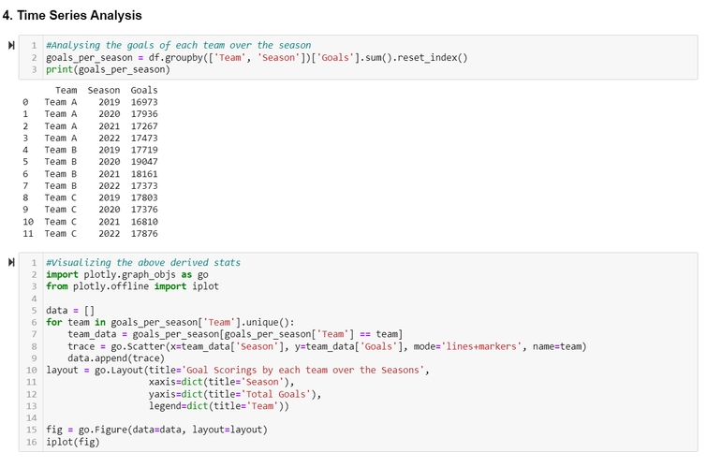
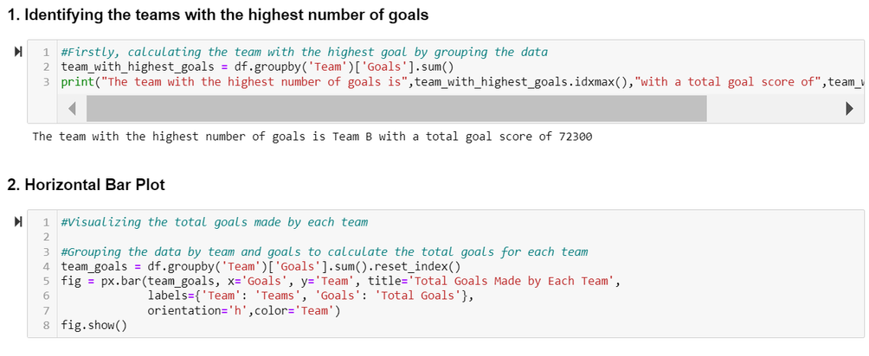
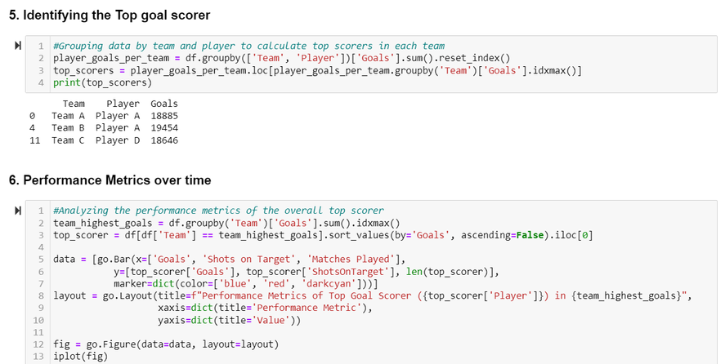
Description
Problem Statement-7: Team Goals Analysis
Identifying teams with the highest number of goals using a horizontal bar plot
Using stacked bar chart to visualize the goals made by each team
Goal scorings of each team over the season
Identifying the top goal scorer and his performance metrics over time

Slide 20
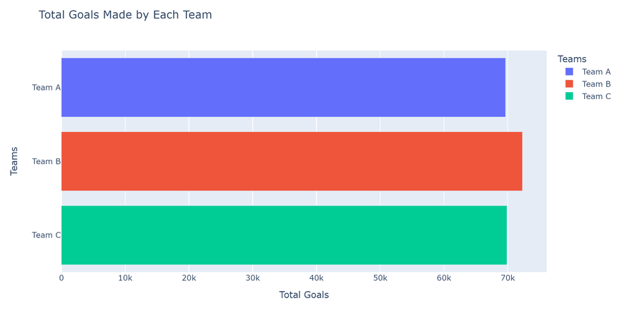
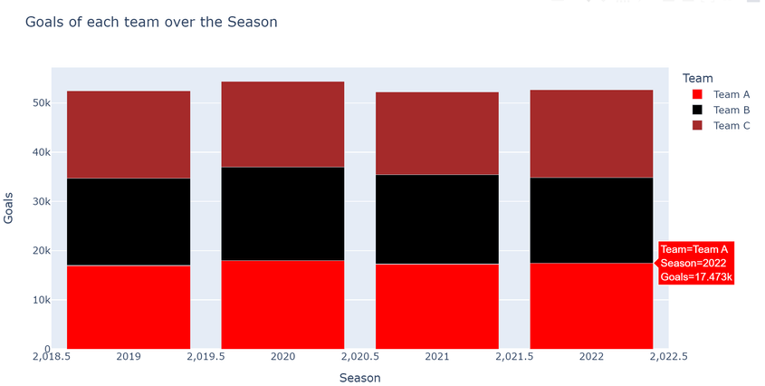
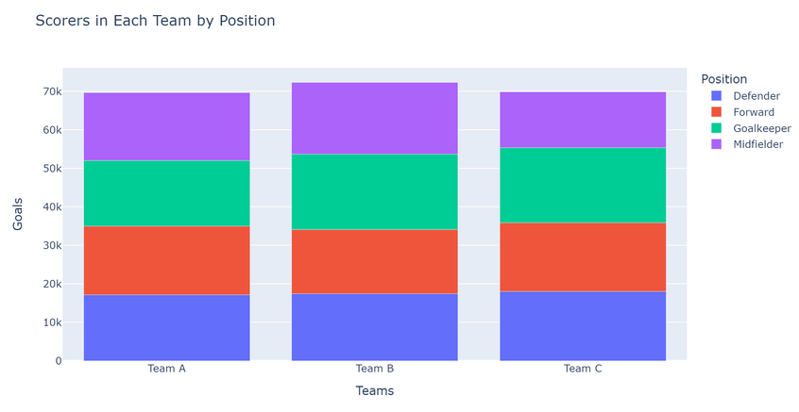
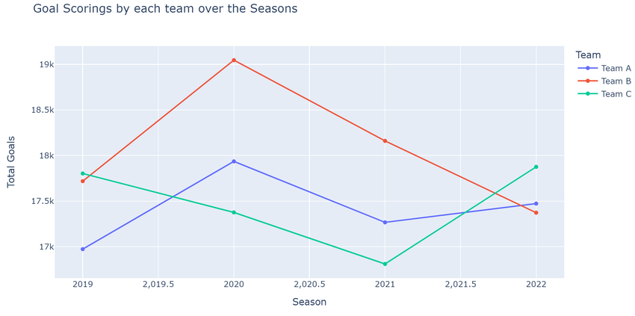
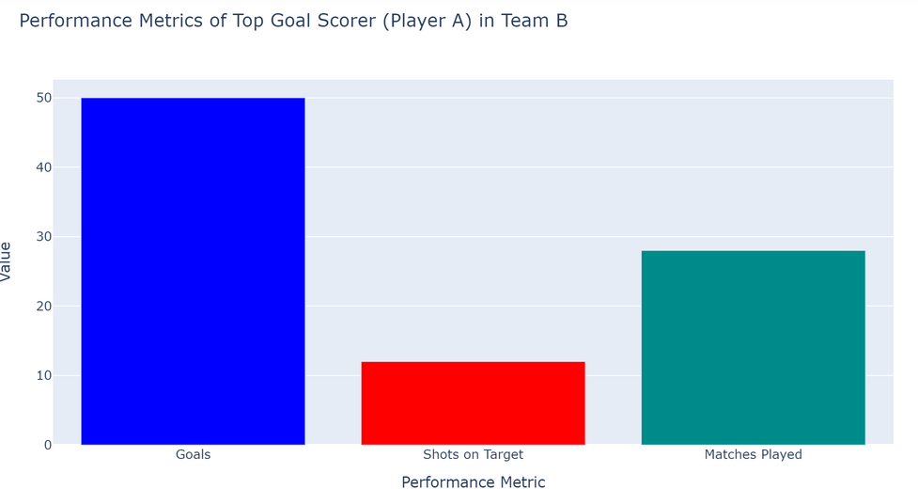
Figures/Graph
Problem Statement 7: Team Goals Analysis

Slide 21
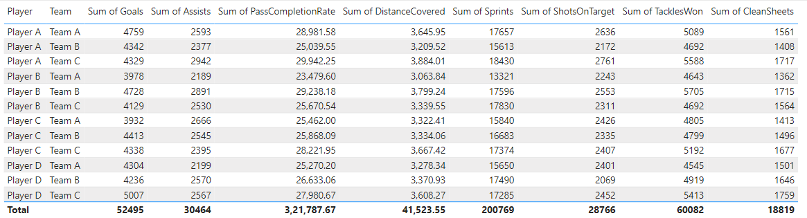
Description
Problem Statement-8: Reporting and Visualization
Player Statistics and Team Statistics in an interactive format of display.
Using clustering techniques for grouping data
Precitive Modelling for comparisons.

Slide 22
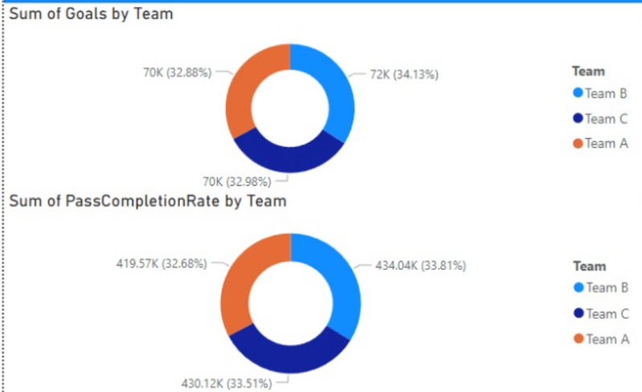
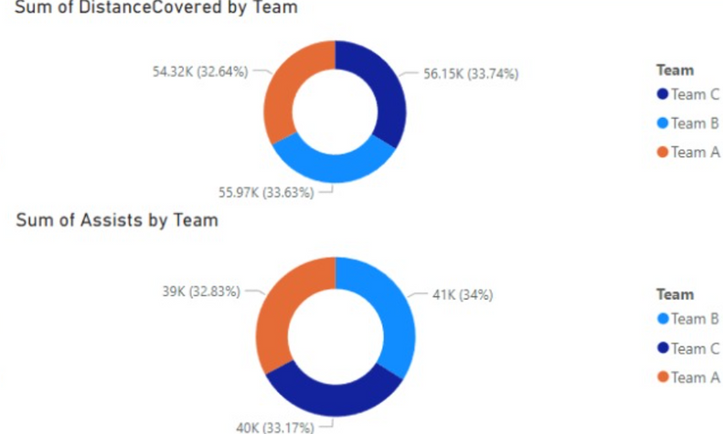
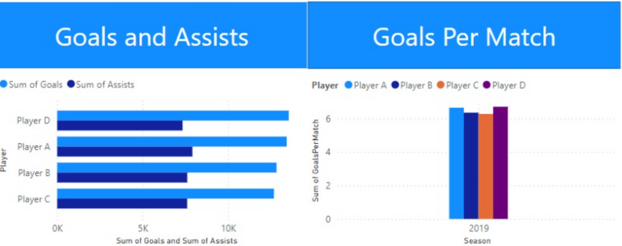
Figures/Graph
Problem Statement 8: Reporting and Visualization

Slide 23
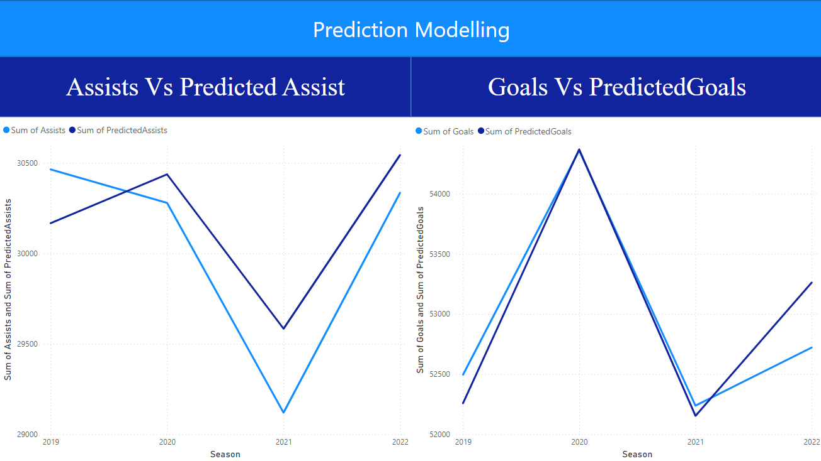
Figures/Graph
Problem Statement 8: Reporting and Visualization

Slide 24
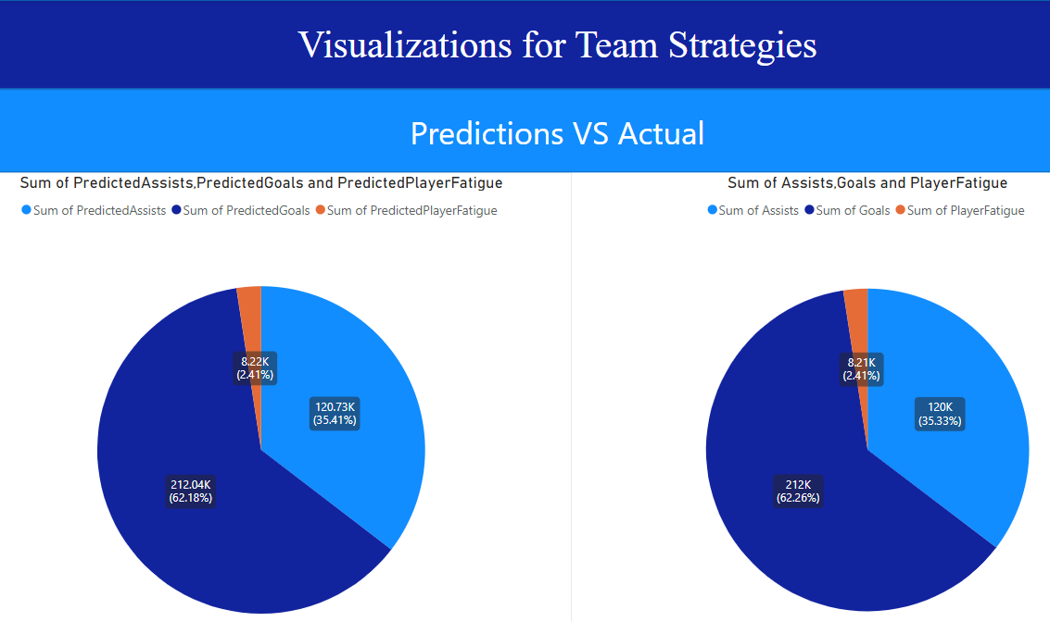
Figures/Graph
Problem Statement 8: Reporting and Visualization

Slide 25
Challenges Faced
Data Cleaning:
Handling Large Datasets: Efficiently processing and manipulating a large volume of player statistics using Python libraries like pandas was crucial.
Null Value and Outlier Management: Utilizing appropriate imputation techniques and outlier detection methods.
Data Pipeline:
Incremental Data Loading: Designing an efficient pipeline that could ingest new data updates seamlessly was a key challenge.
Parallel Processing: Implementing parallel processing required significant expertise to ensure data consistency, limiting the practicality of parallelization.
Data Transformation:
Machine Learning Implementation: Integrating machine learning techniques like clustering and predictive modeling required strong Python skills.
Visualization and reporting:
File Modelling: Accurately reflecting the structure and relationships within the Excel file in Power BI was time-consuming, especially for complex spreadsheets.
Data Table Recognition: Defining relationships between potentially numerous tables within the Excel file for effective analysis in Power BI can be intricate.

Slide 26
Conclusion
Sports Analytics Inc.'s year-long data engineering project has been painstakingly crafted to address the many issues that come with analysing football data. The project intends to convert raw data into usable insights by means of a methodical process that includes data cleaning, augmentation, sophisticated analytics, and visualisation. This will lead to improvements in player performance assessment and team tactics optimisation.

Slide 27
References
Problem Statement 1: Link
Problem Statement 3: Link
Problem Statement 4: Link
Problem Statement 5: Link
Problem Statement 6: Link
Problem Statement 8: Link

Slide 28
Refer to the github repo for project deliverables
GitHub Repository Link:
https://github.com/hithachoudhary/Internship-Phase-2-Capstone-Project.git

Slide 29
Thank you!!!

